Slide 1
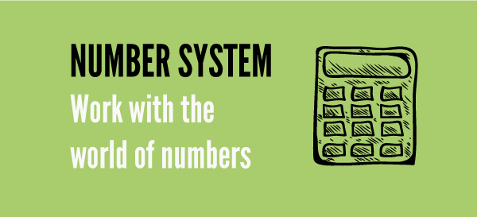
Number Systems

Slide 2

Content
TYPES OF NUMBERS
i) How to find if a number is prime or not
ii) Conversion of a decimal number to fraction
DIVIDSIBILITY RULE
POWER CYCLE
REMAINDER THEOREM
FACTORS AND MULTIPLES
i) Number of factors
ii) Sum of factors
iii) Product of factors
HCF & LCM
AP & GP

Slide 3
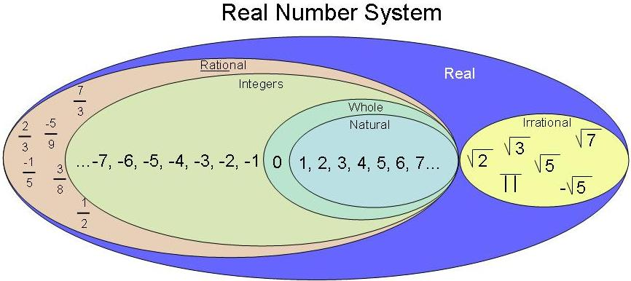
Numbers and its types

Slide 4
What is a rational number?

Slide 5
A rational number is a number which can be expressed in the form of p/q where p & q are integers and q≠0.
Numbers other than rational numbers are called irrational numbers which is non-terminating and non-repeating.
How to find whether a no is Prime or not

Slide 6
What are prime numbers?
How to find whether a no is Prime or not

Slide 7
Prime number is a number which has exactly two factors which is 1 and itself.
Numbers other than prime is called composite numbers which has more than two factors.
How to find whether a no is Prime or not

Slide 8
1.i) How to find if a number is prime or not?
N is a prime number if it is not divisible by numbers lesser than √N.
Example: 191 is a prime number since it is not divisible by 2, 3, 5, 7, 11 and 13 [numbers less than √191 (≈14)].
Note: Prime numbers will always be in the form (6k±1) where k= 1, 2, 3....
But not all (6k±1) will be a prime number.
(6k±1)
prime numbers

Slide 9
If x is a prime number greater than 5 then what is the reminder when x is divided by 6 ?
How to find whether a no is Prime or not

Slide 10
1.ii) Conversion of a decimal number to fraction:
Example: 6.424242.........
Let x = 6.424242....
100x = 642.424242.....
(100x – x)= (642.424242.... – 6.424242.....)
99x = 636
x = 636/99
∴ 6.424242...... = 636/99
= 212/33
How to find whether a no is Prime or not

Slide 11
Divisibility Rules
A number is divisible by
2
If the last digit is even.
3
If the sum of the digits is divisible by 3.
4
If the last two digits of the number divisible by 4.
5
If the last digit is a 5 or a 0.
6
If the number is divisible by both 3 and 2.
7
If the number formed by subtracting twice the last digit with the number formed by;
rest of the digits is divisible by 7. Example: 343. 34-(3x2) = 28 is divisible by 7.
8
If the last three digits form a number divisible by 8.
9
If the sum of the digits is divisible by 9.
10
If the last digit of number is 0.
11
If the difference between sum of digits in even places and the sum of the digits in odd places is 0 or divisible by 11.
Example: 365167484
(3+5+6+4+4) – (6+1+7+8) = 0
∴ 365167484 is divisible by 11.
12
If the number is divisible by both 3 and 4.

Slide 12
Any other numbers can be written in terms of the numbers whose divisibility is already known.
Example: 15 = 3 x 5
18 = 2 x 9
33 = 3 x 11
Note: The numbers expressed should be co-prime (i.e., the HCF of the two numbers should be 1)
Example: 40 = 4 x 10 is wrong because HCF(4,10) is 2.
∴ 40 = 5 x 8 because HCF(5,8) is 1.
How to find whether a no is Prime or not

Slide 13
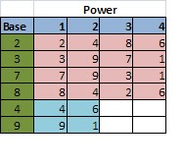
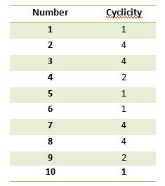
Unit Digit Concept
Choose the nth value in the cycle if the remainder is n except for the last value whose remainder should be 0.

Slide 14
Note: The last digit of an expression will always depend on the unit digit of the values.
Example: The unit digit of 123 x 456 x 789 = 3 x 6 x 9
= 18 x 9
= 8 x 9
= 2
How to find whether a no is Prime or not

Slide 15
Example 2: What is the unit digit of (123)^42?
The unit digit pattern of 3 repeats four times. So find the remainder when the power value is divided by 4.
42/4= R(2)
2nd value in 3 cycle is 9.
∴ Unit digit of (123)^42 is 9
How to find whether a no is Prime or not

Slide 16

Finding Square ??
Squares of numbers ending in 5
25 = 2 X 3 / 25 = 625.
In the same way,
35= 3 X (3+1) /25 = 3 X 4/ 25 = 1225;

Slide 17
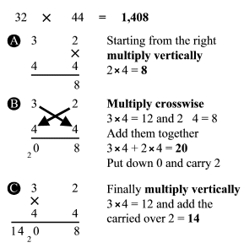
Vedic Maths

Slide 18

Q4.If n is a positive integer and (n + 1)(n + 3) is odd,
then (n + 2)(n + 4) must be a multiple of which one of the following?
A)Even
B)Odd
C)Can’t Determined
D)None

Slide 19
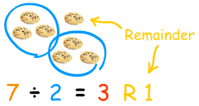
Remainder Theorems :
Type 1: Numerator in terms of powers
The remainder pattern should be found starting from the power of 1. The same procedure should be followed as done in the unit digit concept.

Slide 20
Example: What is the remainder when 2^202 is divided by 7?
2^1/7 = R(2)
2^2/7= R(4)
2^3/7 = R(1)
The next three remainder values will be the same. i.e., The remainder pattern is 2,4,1, 2,4,1, 2,4,1.....
The size of the pattern is 3.
Now divide the power by number of repeating values (3) to choose the remainder.
Choose the nth value in the cycle if the remainder is n except for the last value whose remainder should be 0.
202/3 = R(1).
The 1st value in the cycle is 2.
Note: While finding the remainder pattern if the remainder becomes 1, then the process can be stopped as the it will always repeat after 1.
∴ 2^202/7 = R(2)

Slide 21
Note: While finding the remainder pattern if the remainder becomes 1, then the process can be stopped as the it will always repeat after 1.

Slide 22
Type 2: Different numerator values
Replace each of the values of the numerator by its remainder when divided by the denominator and simplify.
Example: What is the remainder when 13 x 14 x 16 is divided by 6.
13/6 = R(1) ∴ replace 13 by 1
Similarly replace 14 and 16 by 2 and 4 respectively.
∴ (13 x 14 x 16)/6 = (1 x 2 x 4)/6
= 8/6
= R(2)

Slide 23
Note: Do not cancel any numerator value with the denominator value as the remainder will differ.
R(6/4) ≠ R(3/2)
6/4 = R(2)
But 3/2 = R(1)

Slide 24
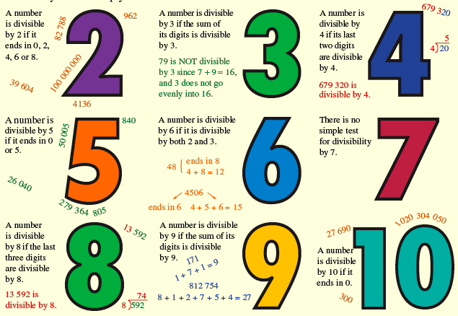
Q 6. What is the remainder when 3 to the power 7 is divided
by 8?
A)3
B)4
C)5
D)7
E)none

Slide 25
Q7. Remainder when 17^23 is divided by 16?
A)1
B)2
C)3
D)4

Slide 26
5. FACTORS
Factor of a number are the values that divides the number completely.
Example: Factors of 10 are 1, 2, 5 and 10.
Multiple of a number is the product of that number and any other whole number.
Example: multiples of 10 are 10, 20, 30,…..

Slide 27
5.i) Number of factors:
Example: 3600
Step 1: Prime factorize the given number
3600 = 36 x 100
= 6^2 x 10^2
= 2^2 x 3^2 x 2^2 x 5^2
= 2^4 x 3^2 x 5^2
Step 2: Add 1 to the powers and multiply.
(4+1) x (2+1) x (2+1)
= 5 x 3 x 3
= 45
∴ Number of factors of 3600 is 45.

Slide 28
5.ii) Sum of factors:
Example: 45
Step 1: Prime factorize the given number
45 = 3^2 x 5^1
Step 2: Split each prime factor as sum of every distinct factors.
(3^0 + 3^1 + 3^2) x (5^0 + 5^1)
The following result will be the sum of the factors
= 78

Slide 29
Factors will occur in pairs for the numbers except perfect squares.
Example: A non perfect square number- 10
1 x 10 = 10
2 x 5 = 10
‘∴ Factors of 10 are 1, 2, 5 and 10.
Non perfect squares will have even number of factors

Slide 30
Example 2: A perfect square number- 16
1 x 16 = 16
2 x 8 = 16
4^2 = 16
∴ Factors of 16 are 1, 2, 4, 8 and 16.
Every perfect square will have odd number of factors because its square root number will pair with itself.
This has odd number of factors because 4 will pair with itself.
Every perfect square will have odd number of factors because its square root number will pair with itself.

Slide 31
Example 3: A prime square number- 49
The factors of 49 are 1, 7 and 49.
Prime square number will have exactly 3 factors (1, that number itself and square root of that number).
If N is a prime square number then the factors are 1, N and √N.

Slide 32
If 11^2, 3^4 and 2^5 are the factors of a x 12^7 x 17^6 x 21^5 then what is the minimum possible value of a?

Slide 33
How many zeros are there in 100!

Slide 34
6. HCF & LCM
The greatest number that will exactly divide a, b and c is HCF(a, b, c).
The greatest number that will divide a, b and c leaving remainder of x, y and z respectively is HCF(a-x, b-y, c-z).
The greatest remainder which when it divides a, b and c will leave the same remainder in each case is HCF(a-b, b-c, c-a).
The least number which is exactly divisible by a, b and c is LCM(a, b, c).
The least number which when divided by a, b and c leaves the same reminder r in each case is LCM(a, b, c) + r.
The least number which when divided by a, b and c leaves the remainder x, y and z respectively is LCM(a, b, c) – K.
This is possible only if a-x = b-y = c-z = K.

Slide 35
FINDING THE H.C.F. OF BIG NUMBERS
For larger numbers you can use the following method:
Step 1 Find all prime factors of both numbers.
Step 2 Write both numbers as a multiplication of prime numbers.
Step 3 Find which factors are repeating in both numbers and multiply them to get H.C.F

Slide 36
FINDING L.C.M. OF BIG NUMBERS
Step 1 Find all the prime factors of both numbers.
Step 2 Multiply all the prime factors of the larger number by those prime factors of the smaller number that are not already included

Slide 37
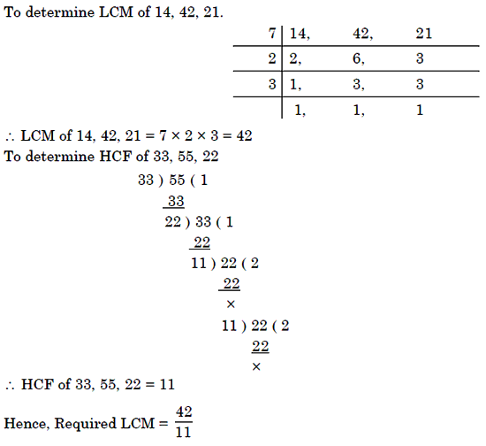

Slide 38

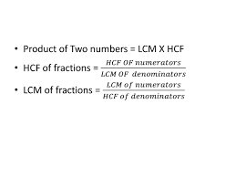
Important formulae:

Slide 39
Four bells ring at an interval 3min, 4min, 5min and 6 minutes respectively. If all the four bells ring at 9am first, when will it ring again?

Slide 40

Q 9. The H.C.F. of two numbers is 11 and their L.C.M. is 7700. If one of the numbers is 275, then the other is:
A)308
B)310
C)312
D)None

Slide 41

Q10. The H.C.F of 9/10, 12/25, 18/35, and 21/40 is?
A)3/1400
B)5/1400
C)7/1400
D)None

Slide 42
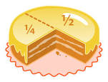
Q11. Which of the following fraction is the largest? 7/8, 13/16, 31/40, 63/80
A)7/8
B)13/16
C)31/40
D)6380

Slide 43

Q12. A, B and C start at the same time in the same direction to run around a circular stadium. A completes a round in 252 seconds, B in 308 seconds and c in 198 seconds, all starting at the same point. After what time will they again at the starting point?
A)26mint 18 sec
B)42 mint 36 sec
C)45 mint
D)46 mint 12 sec

Slide 44
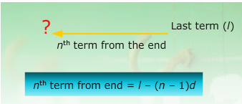
ARITHMETIC PROGRESSION
An Arithmetic Progression (A.P.) is a sequence in which the difference between any two consecutive terms is constant.
Let a = first term, d = common difference
Then nth term

Slide 45


Sum of an A.P

Slide 46
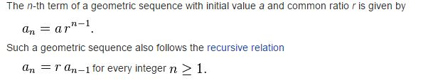

GEOMETRICAL PROGRESSION
A geometric sequence are powers r^{k} of a fixed number r, such as 2^{k} and 3^{k}. The general form of a geometric sequence is
Sum=

Slide 47
Q 8. Find the sum of 1,3,5,7,…199
A)10,000
B)1000
C)5000
d)8000

Slide 48

Next Class Averages

